Slide 1
A Climate–Health Vulnerability Index for Uganda
PROGRAMMING PROJECT · STATISTICAL COMPUTING IV
An object-oriented C++ system using Factor Analysis of Mixed Data, multilevel logistic regression and chi-square tests on UDHS 2022 data
Kuli Faith Rombe · Master of Statistics · Makerere University · November 2026
Notes:
Introduce the project: a household-level Climate-Health Vulnerability Index for Uganda, built and tested entirely inside one object-oriented C++ program. The three objectives are to construct and validate the index, to test its link with fever in children under five, and to test the rural-urban divide.

Slide 2
Student details
Signature
Name
[insert scanned signature]
Kuli Faith Rombe
Registration number
2025/HD06/22009U
Student number
2500722009
Programme and school
Master of Statistics, School of Statistics and Planning, Makerere University
Kuli Faith Rombe · 2025/HD06/22009U
2 / 10
Notes:
Add the student number and paste the scanned signature into the dashed box before presenting.

Slide 3
Background and approach
The problem
How the program solves it
Uganda has no household-level climate–health vulnerability index.
Survey indicators mix continuous, ordinal and nominal variables, which classical PCA cannot handle.
Indices are rarely checked against health outcomes.
IPCC framework: Exposure, Sensitivity and Adaptive capacity, from 16 indicators.
UDHS 2022 (995 households) linked to 32 years of daily weather.
FAMD gives objective weights; CHVI = (E + S − A) / 3.
Tested for robustness, fever risk and the rural–urban divide.
Kuli Faith Rombe · 2025/HD06/22009U
3 / 10
Notes:
Objectives: (1) construct the index and test its robustness, (2) test its association with fever in children under five, (3) test rural-urban disparities. The data are a 10 percent extract of the UDHS 2022 Kids Recode: 1,436 child records, 995 households, 586 clusters, plus Open-Meteo daily weather for 14 regions, 1991 to 2022.

Slide 4
How the program works
1 · Climate z-scores
2 · Recode and impute
3 · FAMD and weights
WeatherProcessor
DHSLoader, FAMDImputer
FAMD
Daily records to annual values, then z = (2021–22 mean − 1991–2020 mean) / SD.
Survey recoding rules; missing categories filled by iterative FAMD.
Design matrix, Jacobi eigen-solver, weights W = Σ L·λ / Σ λ.
4 · The index
5 · Robustness
6 · Tests
IndexBuilder
RobustnessAnalyzer
MixedLogit, ChiSquareTest
E, S, A indices; CHVI = (E + S − A) / 3; z-score; five levels by binary search.
4 vs 12 axes; 200 cluster bootstraps; 100 regression-weight splits.
Random-intercept logit (Gauss–Hermite, BFGS); chi-square and Cramér's V.
To extend: add one line in VariableSchema::build() and one recode in DHSLoader; a new variable type is a subclass of Variable.
Kuli Faith Rombe · 2025/HD06/22009U
4 / 10
Notes:
Walk through the six steps left to right and top to bottom. Stress that every box is one class with one job, and that ResearchSystem calls them in order. Extension: a new indicator needs one add line in VariableSchema::build() plus its recode in DHSLoader::load(); FAMD, imputation, weights and the index adapt because the number of design columns is derived from the schema.

Slide 5
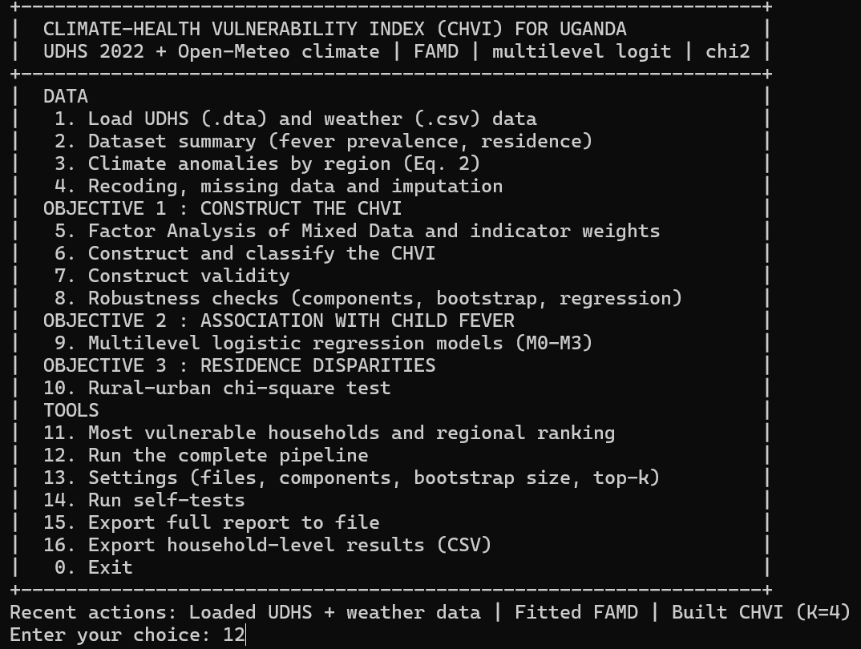
Demonstration and source code
class Variable { // abstract
virtual Kind kind() const = 0;
virtual double normalise(double) const = 0;
};
class ContinuousVariable : public Variable {};
class CategoricalVariable : public Variable {};
class OrdinalVariable : public CategoricalVariable {};
class NominalVariable : public CategoricalVariable {};
// IndexBuilder never asks which type it holds
Y(i, j) = schema.at(j).normalise(x);
Polymorphism in Variable.hpp: one call scores every indicator.
Menu-driven: option 12 runs the full pipeline in about 3 seconds.
Kuli Faith Rombe · 2025/HD06/22009U
5 / 10
Notes:
Live demo plan: start the program, choose 1 to load the .dta and weather files, then 12 for the complete pipeline; show 14 to run the 75 self-tests. Then open Variable.hpp and show the class hierarchy: IndexBuilder calls normalise() through a Variable reference and never checks the type, so adding a type means adding a subclass. Replace the first picture with a real console screenshot from your computer if you prefer.

Slide 6
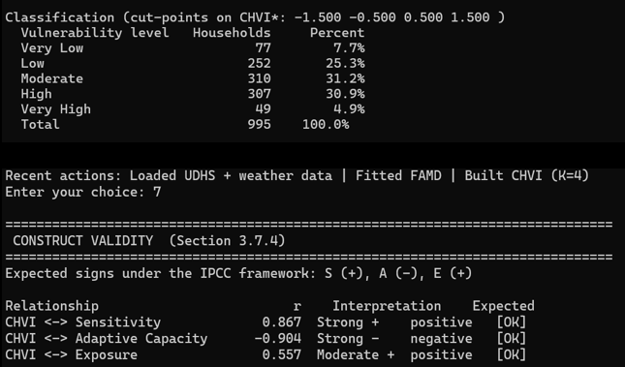
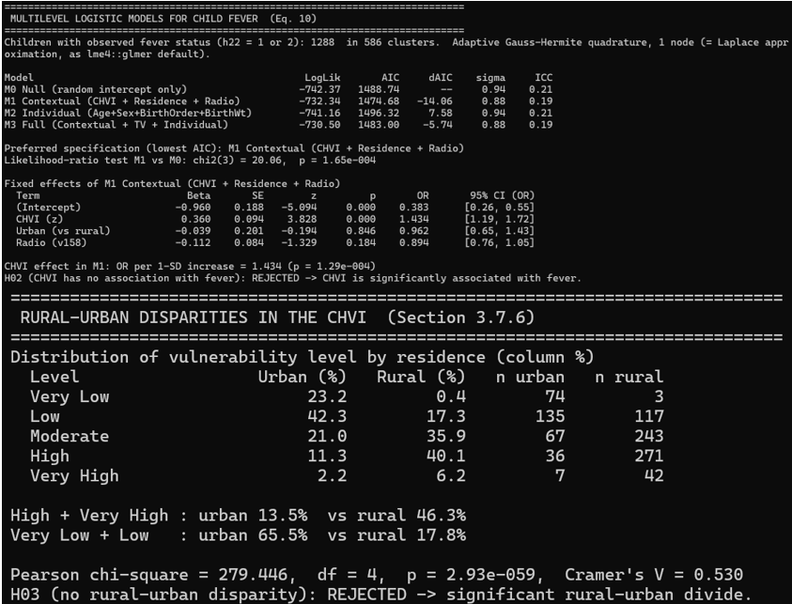
Program output
The index: weights, five classes and construct validity.
The tests: four fever models and the rural–urban chi-square.
Matches Chapter 4: classes 77 / 252 / 310 / 307 / 49, AIC 1488.7 / 1474.7 / 1496.3 / 1483.0, χ² = 279.4, P-Value = 2.93e-059.
Kuli Faith Rombe · 2025/HD06/22009U
6 / 10
Notes:
Left: Wealth, cooking fuel and housing materials have the largest weights, climate anomalies the smallest. CHVI correlates +0.867 with Sensitivity, -0.904 with Adaptive capacity and +0.557 with Exposure. Right: the contextual model M1 has the lowest AIC; one standard deviation of CHVI raises the odds of fever by 43 percent (95 percent CI 1.19 to 1.72); the individual model is worse than the null. Rural households: 46.3 percent High or Very High against 13.5 percent urban (Cramer's V 0.53). These panels are rendered from the real program output; swap in console screenshots if you prefer.

Slide 7
Real-life applications
Target rural climate funding
Prioritise malaria prevention
46% of rural but 13.5% of urban households are highly vulnerable; Karamoja and Bukedi rank highest.
Each SD of CHVI raises the odds of child fever by 43%: aim nets and spraying at high-CHVI households.
Treat WASH and housing as adaptation
Re-use the pipeline
Wealth, fuel, walls and floors carry the largest weights, so upgrades lower vulnerability.
New DHS rounds or other countries need only a new schema and recodes; heaps and hash maps keep lookups fast.
Kuli Faith Rombe · 2025/HD06/22009U
7 / 10
Notes:
Policy uses follow Chapter 5 of the proposal: rural-targeted interventions, WASH and housing treated as climate adaptation, and context-driven malaria prevention. Data structures in real use: a min-heap lists the k most vulnerable households in O(n log k); a hash map resamples enumeration areas in the bootstrap; a sorted vector with binary search classifies households.

Slide 8
Strengths and weaknesses
Strengths
Weaknesses
Reproduces the Chapter 4 results; an independent check agrees to 5 × 10⁻¹⁰.
Modular OOP: a new indicator is one line plus one recode.
75 self-tests; clean under AddressSanitizer; no external libraries.
Reads the Stata file directly; a full run takes about 3 seconds.
Cross-sectional data: association, not causation.
Exposure is regional, so it varies little within a region.
10% extract of UDHS, leaves 90% of the dataset unobserved, which may fail to capture population-level variation or regional disparities.
Regression weights are unstable across splits.
Kuli Faith Rombe · 2025/HD06/22009U
8 / 10
Notes:
Be candid about the limits. The cooking-fuel file has no value labels and the R coding puts 681 households in Coal/Lignite and one in Wood, which suggests shifted labels. Bugisu annual rainfall falls from about 7,000 mm to 2,100-5,100 mm after 2015, which looks like a source artefact. Over 100 random splits the Exposure weight from the regression ranges from 0.01 to 0.90, so the equal-weighted index is kept.

Slide 9
Conclusions and recommendations
0.998
1.43
46% vs 14%
Spearman ρ, 4 vs 12 axes: the index is robust (H01 rejected)
Odds ratio of fever per SD of CHVI (H02 rejected)
Rural vs urban households in the High or Very High classes (H03 rejected)
Recommendations
Keep equal weights.
Link exposure to household GPS points.
If possible use more than 50% of the UDHS extract
Kuli Faith Rombe · 2025/HD06/22009U
9 / 10
Notes:
Percentages: 46.3 percent of rural and 13.5 percent of urban households are High or Very High (chi-square 279.4, 4 df, Cramer's V 0.53). The CHVI is driven mostly by wealth and housing, so a useful next test is whether it predicts fever better than the wealth quintile alone.

Slide 10
Appendix: testing evidence and code
Test layer | Result
Unit checks | 75 of 75 pass: linear algebra, statistics, recoding, weather, models
Independent counts | 1,436 records, 426 urban, 352 yes and 936 no for fever (pandas)
Chapter 4 replication | Weights, classes, correlations, ρ, AIC and χ² identical
Cross-validation | Python re-implementation: CHVI differs by 5 × 10⁻¹⁰; 995 classes identical
Sensitivity | Blank water time coded "on premises": ρ = 0.9975 with the main CHVI
Build | Strict C++11 and C++17 without warnings; AddressSanitizer clean
18 source files · 3,474 lines · 16 menu options · output files: full_report.txt, selftest_output.txt, households_chvi.csv
Kuli Faith Rombe · 2025/HD06/22009U
10 / 10
Notes:
Use this slide to answer questions on testing. The Python cross-check is tools/oracle_check.py; one bug was found by testing (the Stata reader missed the missing-value code for double fields) and fixed with a regression check.

